Slide 1


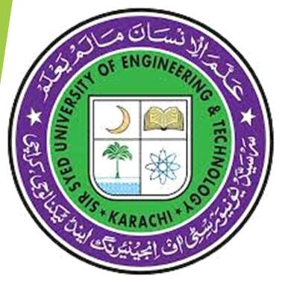
2nd Chapter
Five Pillars of Islam
1st Pillar Deliration of Islam/Kalima-e-Tayyib 2nd Pillar Prayer/Salah/Namaz
3rd Pillar Fasting/Soam/Roza 4th Pillar Zakat (Obligatory Charity)
5th Pillar Hajj/Pilgrimage
Ms. SAFIA WAQAS
Session: Spring: 2025
Course: Islamic Studies / Ethical Behavior

Slide 2
Five Pillars of Islam
◆ Topics:
Introduction to Islam. What is Islam?
Five Pillars of Islam and Core Principles of Islam
The Purpose of Islam
◆ 1st Pillar – Declaration of Islam (Kalima-e-Tayyib) Requirements of the Kalima-e-Tayyib
Understanding Iman-e-Mujmal: The Heart of Islamic Faith
◆ Two Testimonies of Faith (Shahadatayn)
Significance of the Two Testimonies

Slide 3
Introduction to Islam. What is Islam?
What is Islam?
The word "Islam" means "submission" or "surrender" to Allah.
It is a way of life based on obeying Allah’s commands.
Purpose of Islam:
To worship Allah only
To live a good and fair life.
To grow spiritually and prepare for the life after death.

Slide 4
The Five Pillars of Islam
Five Pillars of Islam: Core Principles of Islam:
Shahada: Declaration of Faith
Salah (Prayers): Performing the five daily prayers.
Zakat (Charity): Giving a portion of your wealth to those in need.
Sawm(Fasting): Fasting during the month of Ramadan.
Hajj (Pilgrimage): Making a pilgrimage to Mecca if you are able.
These acts build a strong, balanced life and
connect a Muslim to their faith.
Tawhid (Oneness of Allah): Belief in the oneness of Allah.
Risalah (Prophethood): Belief in the Prophethood (especially Prophet Muhammad).
Akhirah (Afterlife): Belief in life after death.
Adl (Justice): Belief in justice.
Ihsan (Goodness): Belief in doing good and being kind.

Slide 5
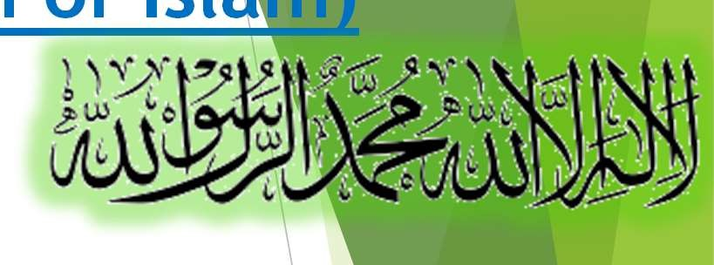
1st Pillar–Kalima-e-Tayyib (Declaration of Islam)
What is Kalima-e-Tayyib?
The Kalima-e-Tayyib is the pure and clear declaration of a Muslim’s faith. The Kalima:
"There is no god but Allah, and Muhammad is the Messenger of Allah.“
Requirements of the Kalima-e-Tayyib:
Belief in One God (Tawhid): Truly believe that only Allah is worthy of worship.
Belief in Prophet Muhammad: Accept Prophet Muhammad (ﷺas Allah’s final messenger.
Sincere Acceptance: The belief must come from deep within the heart. Believe with your heart, speak with your tongue, and act according to your words.

Slide 6
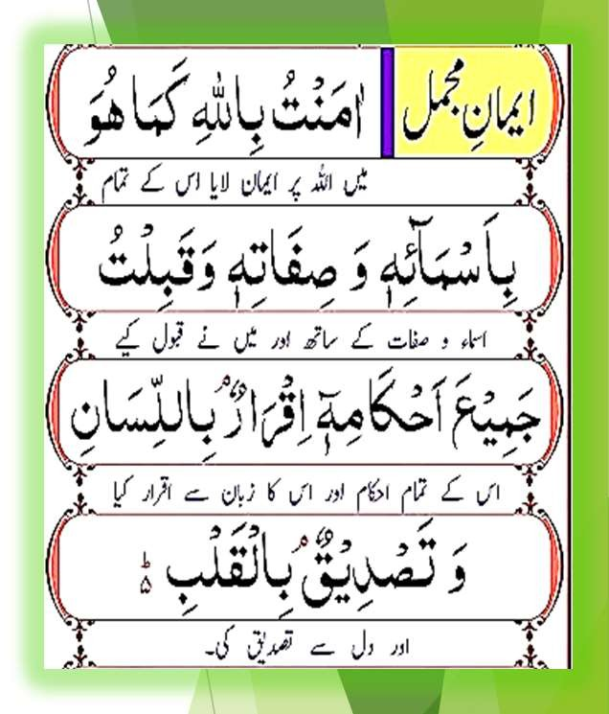
Understanding Iman-e-Mujmal: The Heart of Islamic Faith
Iman-e-Mujmal (Brief Faith):
“I have faith in Allah as He is with all His Names and Attributes, and I accept all His commands.”
Belief: Iman-e-Mujmal means believing in Allah completely with all His names and qualities.
Spiritual Purification: The Kalima cleanses your soul by reminding you of Allah’s power and the teachings of Prophet Muhammad (ﷺ)
Unity of Purpose: The Kalima brings Muslims together, creating a shared belief and purpose around Allah’s message.
Accountability: It reminds us of the Day of Judgment and inspires us to act righteously.

Slide 7


Two Testimonies of Faith
The Two Important Declarations:
1. Testimony of Monotheism (Shahada of Tawhid):
2. Testimony of Prophethood (Shahada of Risalah):
“There is no god but Allah.”
This shows our belief in one God.
“Muhammad is the Messenger of Allah.”
This shows our belief in the guidance brought by Prophet Muhammad.
One God, One Messenger: Islam is about believing in only one God (Allah) and that Muhammad (peace be upon him) was his prophet. Promise to God: Saying the testimonies means you promise to only worship God and follow Muhammad's teachings.

Slide 8
2nd Pillar - Prayer / Salah / Namaz
◆ Topics:
What Is Prayer?
Qualities and Importance of Prayer
Consequences of Skipping Prayer & Hereafter Consequences
Catching Up on Missed Prayers (Qada)
Benefits of Establishing Salah
◆ Prayer from a Modern Science Perspective
Hereafter Benefits of Prayer

Slide 9
2nd Pillar – Prayer (Salah/Namaz)
What Is Prayer? : Prayer, also known as Salah or Namaz, is a special way for Muslims to talk to Allah. It is the second most important act of worship in Islam.
Direct Talk with Allah: Prayer is like having a direct conversation with Allah. It is a time when you speak to Him, ask for help, and say thank you.
Prayer connects us with Allah and cleanses our sins.
It is a key part of a successful and balanced life.
Quranic Verses: “Establish prayer, for prayer prevents indecency and evil.”
(Surah Al-Ankabut, 29:45)
“Indeed, prayer has been decreed upon the believers at specified times.”
(Surah An-Nisa, 4:103)
“Successful indeed are the believers, those who humble themselves in their prayer.”
(Surah Al-Mu’minun, 23:1-2)

Slide 10
Qualities and Importance of Prayer
Cleansing of Sins: Regular prayers help erase minor sins
(Hadith: Five daily prayers and Jumu’ah expiate sins if major sins are avoided)
Spiritual Elevation: Brings inner peace and strengthens faith
“Verily, in the remembrance of Allah do hearts find rest.”
(Surah Ar-Ra’d, 13:28)
Path to Paradise: Prayer is the first deed questioned on the Day of Judgment A sound prayer means other deeds will be sound (Hadith from Tirmidhi)

Slide 11
Consequences of Skipping Prayer
Worldly Consequences:
Loss of Blessings:
Skipping prayer can lead to missed opportunities for blessings in life.
Without the regular act of prayer, you might
face unexpected hardships and challenges. (Surah Taha, 20:124)
Spiritual Deprivation:
When you do not pray, your heart may feel
empty and lose its connection with Allah. This spiritual distance can lead to a lack of inner peace and a feeling of emptiness.
Social Impact:
Missing prayer can weaken self-discipline and moral values.
Hereafter Consequences:
Severe Punishment: In the Hereafter, those who consistently neglect prayer may face harsh punishment.
This warning serves as a reminder to maintain
regular prayer to protect oneself from divine retribution. (Surah Al-Muddathir, 74:42-43) Loss of Intercession: Prayer is a means by which the Prophet (ﷺ)intercedes on behalf of believers.
Neglecting prayer means you might miss out on this help on the Day of Judgment.
Dire Outcome: Persistent neglect of prayer can
lead to very serious consequences in the life after death.
A society where many skip prayer may struggle It is seen as a major failing that can overshadow with maintaining ethical and moral standards. even other good deeds.
(Surah Al-Ma’un, 107:4-5)

Slide 12
Catching Up on Missed Prayers (Qada)
When to Make Up:
If you miss a prayer by accident (like falling asleep or forgetting), make it up as soon as you remember.
Hadith Guidance:
“Whoever forgets a prayer, let him pray it as soon as he remembers. There is no expiation other than this.” (Bukhari, Muslim)
Conditions for Qada:
Sincere repentance for missing the prayer
Resolve not to repeat the mistake
Note on Deliberate Neglect:
Skipping prayer on purpose is a serious sin.
It requires both making up the missed prayer and true, heartfelt repentance.

Slide 13
Benefits of Establishing Salah
Forgiveness and Mercy:
Prayer is a way to ask for forgiveness and receive Allah’s mercy
“O you who have believed, seek help through patience and prayer. Indeed, Allah is with the patient.”
(Surah Al-Baqarah, 2:153)
Unity of the Ummah:
Congregational prayers build strong community bonds
Divine Protection:
Prayer acts as a shield, protecting one from evil and misdeeds

Slide 14
Prayer from a Modern Science Perspective
What Science Says:
Prayer is similar to meditation and deep reflection.
It benefits our body, mind, and emotions.
Key Points:
Mindfulness: Helps you stay present and aware.
Stress Reduction: Lowers stress and anxiety levels.
Improved Focus: Boosts concentration and self-discipline.

Slide 15
Hereafter Benefits of Prayer
Path to Forgiveness: Prayer Opens the door to Allah’s mercy and cleanses the soul (Surah Hud, 11:114)
First Accountability: On the Day of Judgment, prayer is the first act to be judged.
(Hadith from Tirmidhi)
Reward in Paradise: Praying regularly brings blessings and rewards in Paradise.
(Surah Al-Mu’minun, 23:1-2)
Protection from Hellfire: Prayer acts like a shield, protecting you from punishment.
(Hadith from Muslim)
Elevated Status: Regular prayer increases your rank and status in the sight of Allah.

Slide 16
3rd Pillar - Fasting/Soam/Roza
◆ Topics:
Fasting as an Obligation
Virtues of Fasting in Ramadan
Importance of Fasting
Consequences of Neglecting Fasting
Punishment for Intentionally Skipping or Breaking a Fast
◆ Worldly Benefits of Fasting According to Modern Science

Slide 17
Fasting as an Obligation
Key Points:
Fasting is required for every adult, sane, and capable Muslim.
It is clearly mentioned in the Quran and Hadith.
Quran Verses:
“O you who have believed, fasting is prescribed for you…” (Surah Al-Baqarah 2:183)
“The month of Ramadan [is that] in which was revealed the Qur'an…” (Surah Al-Baqarah 2:185)
Hadith Reminder:
The Prophet Muhammad (ﷺ) said, “Islam is built upon five pillars…” (Bukhari)

Slide 18
Virtues of Fasting in Ramadan
Attaining Taqwa (Piety):
Fasting helps increase God-consciousness and self-restraint.
Immense Rewards:
Good deeds are multiplied, and fasting is specially rewarded by Allah.
Forgiveness of Sins:
Fasting with true faith leads to the forgiveness of past sins.
Entry into Paradise:
A special gate in Paradise (Ar-Rayyan) is for those who fast.
Spiritual Upliftment:
Ramadan, the month of the Quran, strengthens our bond with Allah’s word.

Slide 19
Importance of Fasting
Obedience to Allah:
Fasting shows our submission to Allah’s commands.
Detachment from Material Desires:
It helps control physical urges like eating, drinking, and marital relations during daylight.
Empathy for the Poor:
Experiencing hunger makes us more compassionate toward those in need.
Health Benefits:
Fasting cleanses the body, sharpens the mind, and improves overall health.
Communal Bonding:
Fasting brings Muslims together around the world in worship and unity.

Slide 20
Consequences of Neglecting Fasting
Spiritual and Moral Consequences:
Breaking or skipping a fast without a valid reason is a serious sin.
Quranic Warning:
Deliberate disobedience in fasting labels one among the sinners.
Hadith Warning:
The Prophet warned that those who break the fast may face severe consequences, symbolized by the image of “cheeks being torn.”
Worldly and Hereafter Losses:
Loss of Allah’s mercy, spiritual decline, and missing the gate of Ar-Rayyan in Paradise.
Possible punishment in the grave and Hellfire.

Slide 21
Punishment for Intentionally Skipping or Breaking a Fast
According to the Quran:
Those who ignore Allah’s command may be held accountable on the Day of Judgment. Skipping the fast is seen as neglecting a vital duty.
According to the Hadith:
The Prophet (ﷺ) warned of severe consequences for breaking the fast.
If a fast is deliberately broken (by eating, drinking, or marital relations), the person must:
Fast for two consecutive months (60 days), or
Feed 60 poor people (expiation).
A missed fast also means losing the immense rewards promised by Allah.

Slide 22
Worldly Benefits of Fasting According to Modern Science
Metabolic Health:
Helps control blood sugar, reduces insulin resistance, and improves cholesterol levels.
Detoxification & Cell Repair:
The body cleans out toxins and repairs cells (process called autophagy).
Weight Loss:
Supports fat burning and helps reduce body fat.
Enhanced Brain Function:
Increases brain chemicals (like BDNF) that boost brain health and protect against diseases.
Reduced Inflammation:
Lowers inflammation, reducing the risk of many chronic illnesses.
Heart Health:
Helps lower blood pressure and improve overall cardiovascular health.
Mental Clarity & Emotional Balance:
The discipline of fasting can improve focus, mental clarity, and emotional stability.

Slide 23
4th Pillar Zakat (Obligatory Charity)
◆ Topics:
What is Zakat & Translation of Verse 60 of Surah At- Tawbah.
Recipients of Zakat
Restrictions on Giving Zakat
Virtue & Importance of Paying Zakat
Importance of Zakat in Society
◆ Warnings and Consequences for Not Paying Zakat

Slide 24
What is Zakat & Translation of Verse 60 of Surah At-Tawbah.
◆ What is Zakat?
Zakat is a core duty in Islam and one of the five pillars. It is meant to purify wealth, help those in need, and balance society.
◆ Translation of Verse 60 of Surah At-Tawbah
“Zakat expenditures are only for the poor and the needy, and those employed to collect it, and for bringing hearts together [for Islam], and for freeing captives [slaves], and for those in debt, and for the cause of Allah, and for the [stranded] traveler—an obligation [imposed] by Allah. And Allah is Knowing and Wise.”
(Surah At-Tawbah, 9:60)
This verse clearly explains the specific purposes for which Zakat should be spent.

Slide 25
Recipients of Zakat
Who Can Receive Zakat? The Poor (Al-Fuqara):
◆ Those who do not have enough money for basic needs.
The Needy (Al-Masakin):
◆ People who are slightly better off than the poor but still need help.
Zakat Collectors (Al-‘Amileen ‘Alayha):
◆ Individuals appointed to collect, manage, and distribute Zakat.
Those Whose Hearts Need to be Reconciled (Mu'allafatul Quloob):
◆ New converts or people who need support to strengthen their faith.
For Freeing Captives (Fi Ar-Riqab):
◆ Assisting slaves or prisoners to gain freedom.
For Those in Debt (Al-Gharimeen):
◆ Helping individuals burdened with debts incurred for lawful reasons.
In the Cause of Allah (Fi Sabeelillah):
◆ Supporting projects that serve Islam (e.g., building mosques, religious education).
The Stranded Traveler (Ibn As-Sabeel):
◆ Travelers who have run out of money and need help to return home.

Slide 26
Restrictions on Giving Zakat
◆ Zakat Must Only Go to the Above Eight Groups:
◆ It cannot be given to:
◆ Wealthy or self-sufficient individuals.
◆ Direct family members (parents, children, grandparents, etc.).
◆ One’s own spouse.
◆ Any cause not mentioned in the eight categories.
Zakat is a sacred duty with clear guidelines that must be followed exactly as revealed by Allah.

Slide 27
Virtue & Importance of Paying Zakat
◆ Why is Zakat Important?
◆ It is a pillar of Islam and an obligation for every eligible Muslim.
◆ Zakat purifies one’s wealth and soul, removing greed and selfishness.
◆ Virtues of Zakat:
◆ Purification of Wealth and Soul:
◆ Helps cleanse our wealth and our hearts from materialism.
◆ Quran Reminder: “Take from their wealth a charity by which you purify them...” (Surah At-Tawbah, 9:103)
◆ Increased Blessings and Sustenance:
◆ The act of giving brings barakah (divine blessings) to one’s wealth.
◆ The Prophet (ﷺ) said, “Wealth is not diminished by giving in charity.”
◆ Compassion and Social Solidarity:
◆ Bridges the gap between rich and poor, encouraging unity.
◆ Divine Reward & Key to Paradise:
◆ Zakat is seen as a sign of faith and a way to earn Allah’s rewards.
◆ Hadith Example: “Charity extinguishes sins as water extinguishes fire.” (Tirmidhi)

Slide 28
Importance of Zakat in Society
◆ Economic Stability:
Redistributes wealth to reduce poverty and economic differences.
◆ Obligation in Islam:
Just as important as prayer and fasting, fulfilling Zakat shows obedience to Allah.
◆ Moral Responsibility:
Promotes empathy and care for the less fortunate.
◆ Spiritual Development:
Helps remove the heart from excessive materialism and connects it to Allah.

Slide 29
Warnings and Consequences for Not Paying Zakat
◆ Spiritual Warnings:
◆ Neglecting Zakat is a serious sin that invites Allah’s anger.
◆ Quran Warning: “And those who hoard gold and silver and spend it not in the way of Allah—give them tidings of a painful punishment.” (Surah At-Tawbah, 9:34)
◆ Hadith Warning:
◆ The Prophet (ﷺ) warned that wealth not given in charity may bring severe punishment, symbolized by vivid imagery.
◆ Worldly Consequences:
◆ Loss of blessings and barakah in wealth.
◆ Increased social problems such as poverty, greed, and lack of unity.
◆ Possible divine punishments (e.g., drought, famine).
◆ Hereafter Consequences:
◆ Severe torment and regret on the Day of Judgment.
◆ Loss of Paradise and Allah’s mercy.
◆ Rejection of the Prophet’s negotiation.
As Muslims, fulfilling our Zakat obligation not only cleanses our wealth but also helps build a caring and just community, ultimately paving the way for eternal rewards in the Hereafter.

Slide 30
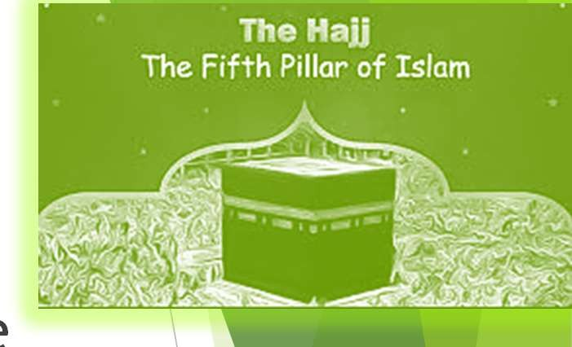
5th Pillar Hajj/Pilgrimage
◆ Topics:
The Fifth Pillar: Hajj - Quran & Hadith Evidenc
Benefits of Hajj
Importance of Hajj
◆ Warning and Consequences for Neglecting Hajj
Rituals of Hajj (Manasik-e-Hajj)
Ritual 1 – Ihram (State of Purity)
Ritual 2 – Tawaf (Circumambulation of the Kaaba) & Ritual 3 – Sa’i (Walking Between Safa and Marwah)
Ritual 4 – Wuquf at Arafat (Standing at Arafat) & Ritual 5 – Muzdalifah (Collecting Pebbles)
Ritual 6 – Rami al-Jamarat (Stoning the Pillars) & Ritual 7 – Qurbani (Animal Sacrifice) Additional Rituals of Hajj
e

Slide 31
The Fifth Pillar: Hajj - Quran & Hadith Evidence
◆ Obligation of Hajj: Hajj is a required act of worship for every eligible Muslim at least once in their lifetime.
Hajj is one of the five pillars of Islam. It is a special journey to the holy city of Makkah. Hajj is an act of worship, submission, and unity for Muslims who are physically and financially able.
Quranic Evidence:
“And [due] to Allah from the people is a pilgrimage to the House—for whoever is able to find a way thereto...” (Surah Aal-e-Imran, 3:97)
This verse reminds us that performing Hajj is a duty and neglecting it shows ungratefulness.
Hadith Evidence:
The Prophet Muhammad ( (ﷺsaid, “Islam is built on five pillars… and performing Hajj to the House (Kaaba) for those who are able to do so.” (Bukhari, Muslim)
He also urged, “Hasten to perform Hajj, for no one knows what will happen to him.” (Musnad Ahmad)

Slide 32
Benefits of Hajj
◆ Forgiveness of Sins:
The Prophet (ﷺ) said, “Whoever performs Hajj and does not commit any obscenity or wrongdoing will come out as the day he or she was born—pure and free of sins.” (Bukhari, Muslim)
◆ Massive Rewards:
A successful and accepted Hajj earns the reward of Paradise.
◆ Unity and Brotherhood:
Hajj brings together Muslims from all over the world, showing equality and unity regardless of race or status.
◆ Renewal of Faith:
The journey strengthens our connection with Allah and renews our spiritual energy.
◆ Witnessing Sacred Rituals:
Pilgrims follow the footsteps of the Prophets, remembering the examples of Prophet Ibrahim (AS) and Prophet Muhammad (ﷺ).

Slide 33
Importance of Hajj
◆ Test of Submission:
Hajj requires sacrifice, patience, and devotion, proving our willingness to obey Allah.
◆ Connection with Holy History:
Pilgrims revisit sites linked to Prophet Ibrahim (AS) and his family, deepening their bond with Islamic heritage.
◆ Fulfillment of a Pillar of Islam:
Not performing Hajj without a valid reason is seen as a lack in one’s faith.
◆ Promotion of Taqwa (Piety):
The formal procedure(rituals) help teach humility, discipline, and a strong awareness of Allah in our hearts.

Slide 34
Warning & Consequences for Neglecting Hajj
◆ Quranic Warning:
“And whoever disbelieves—then indeed, Allah is free from need of the worlds.” (Surah Aal- e-Imran, 3:97)
Neglecting Hajj is a sign of ingratitude and rising against Allah.
◆ Hadith Warning:
The Prophet (ﷺ) warned, “Whoever possesses provisions and a means of transportation to bring him to the House of Allah and yet does not perform Hajj…” (Tirmidhi, Ahmad)
◆ Worldly Harm:
Spiritual Decline: Missing Hajj weakens faith and reduces blessings (barakah) in life.
Social Disconnection: Hajj builds community bonds.
◆ Harm in the Hereafter:
Accountability: Those who ignore Hajj will be questioned by Allah on the Day of Judgment.
Loss of Forgiveness: They miss the chance to have their sins wiped away and lose the reward of Paradise.

Slide 35
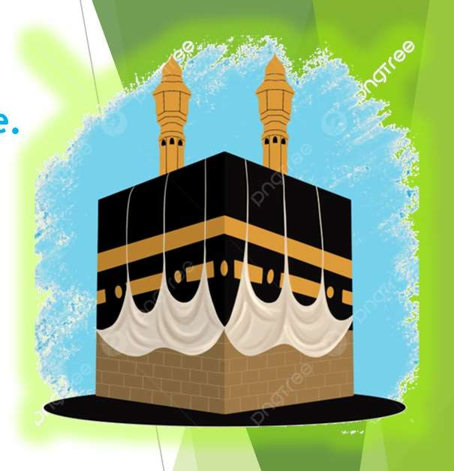
Rituals of Hajj (Manasik-e-Hajj)
Hajj has specific rituals performed in a fixed order.
There are seven main rituals, each with a special meaning and purpose.
Ritual 1 – Ihram (State of Purity)
Definition: Entering a holy state of purity before starting Hajj.
How to Prepare:
Men wear two unstitched white cloths.
Women dress modestly, following Islamic guidelines.
Recitation: Pilgrims recite the Talbiyah:
“Labbayka Allahumma Labbayk. Labbayka la sharika laka labbayk. Inna al-hamda wa an- ni'mata laka wal-mulk. La sharika lak.”
(Meaning: “Here I am, O Allah, here I am. You have no partner. Here I am. Verily, all praise, blessings, and sovereignty belong to You.”)

Slide 36
Ritual 2 – Tawaf (Circumambulation of the Kaaba)
Definition: Walking around the Kaaba seven times in a counterclockwise direction.
Importance:
Symbolizes the central role of the Kaaba and unity with Allah.
How to Perform:
Start at the Black Stone (Hajr Aswad) and complete seven circuits while praying and supplicating.
Ritual 3 – Sa’i
(Walking Between Safa and Marwah)
Definition: Walking back and forth between the hills of Safa and Marwah seven times.
Importance:
Remembers Hagar’s search for water for her son, Ismail (AS) and Allah’s miracle of providing Zamzam water.
How to Perform:
Begin at Safa, move to Marwah, and repeat, reciting prayers and supplications.

Slide 37
Ritual 4 – Wuquf at Arafat (Standing at Arafat)
Definition:
Walking around the Kaaba seven times in a counterclockwise direction.
Importance:
Symbolizes the central role of the Kaaba and unity with Allah.
How to Perform:
Start at the Black Stone (Hajr Aswad) and complete seven circuits while praying and supplicating.
Ritual 5 – Muzdalifah (Collecting Pebbles)
Definition:
After sunset on the Day of Arafat, pilgrims travel to Muzdalifah.
Actions:
Pray Maghrib and Isha together.
Collect 49 or 70 pebbles for use in the next ritual.

Slide 38
Ritual 6 – Rami al-Jamarat (Stoning the Pillars)
Definition:
◆ Throwing pebbles at three pillars in Mina that represent Satan’s temptations.
How to Perform:
◆ Begin on the 10th of Dhul-Hijjah by throwing seven pebbles at the largest pillar (Jamarat al-Aqaba), then continue for the other pillars.
Importance:
◆ This act symbolizes the rejection of evil and the commitment to follow Allah’s guidance..
Ritual 7 – Qurbani (Animal Sacrifice)
Definition:
◆ Sacrificing an animal (such as a sheep, goat, cow, or camel) to remember Prophet Ibrahim’s (AS) willingness to sacrifice his son, Ismail (AS).
Importance:
◆ Shows obedience to Allah and provides meat for the poor.

Slide 39
Additional Rituals of Hajj
Tawaf al-Ifadah:
Another circumambulation of the Kaaba performed after the main rituals, symbolizing spiritual cleansing.
Halq or Taqsir (Shaving or Trimming Hair):
Men shave or trim their hair; women cut a small portion. This act represents humility and renewal.
Tawaf al-Wada (Farewell Tawaf):
The final circumambulation before leaving Makkah, marking the conclusion of Hajj.

